Slide 1
Lecture 6: The RSA Cryptosystem and Factoring Integers -Cryptographic Algorithms and Protocols
Huang, Xiujie (黄秀姐)
Office: Nanhai Building, #411
E-mail: t_xiujie@jnu.edu.cn
Dept. Computer Science

Slide 2
Outline
1. Introduction to Public-Key Cryptography
SKC v.s. PKC
2. Mathematical Backgrounds III
3. The RSA Cryptosystem
4. Implementing RSA and Complexity
5. Attacks on RSA
6. The Rabin Cryptosystem
Turing Reduction
7. Semantic Security of RSA

Slide 3

Why PKC?
Question:
Alice wants to send Bob a secret through Internet against Hacker.
Encryption
Internet
secret
Security?
Hacker
3

Slide 4
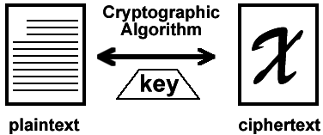

Why PKC?
Solution 1: SKC
Drawback: The key should be transmitted in a secure channel and kept in a secure place.
SKC
Internet
secret
secure channel
4

Slide 5


Why PKC?
Solution 2: PKC
Advantage: The encryption key is public.
Disadvantage: 1.Certificate Management; 2.The computation complexity is usually higher than SKC.
Internet
PKC
secret
CA, 8.6
TA, 13.1
Bob’s public key
Bob’s private key
5

Slide 6
Why PKC?
The Hybrid Cryptography: an intuitive combination of SKC and PKC
Use SKC to encrypt “long” message
Use PKC to encrypt the secret key of SKC.
(Key management is one important topic of PKC.)
6

Slide 7
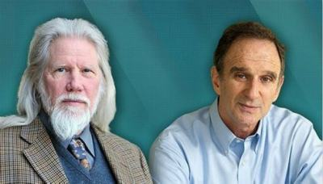
Brief History of PKC
1970, James Ellis, “The possibility of non-secret encryption” (PKC)
1973, Clifford Cocks, “A note on non-secret encryption” (RSA)
1976, Diffie and Hellman, the idea of PKC
released in 1997
Bailey Whitfield Diffie
Martin Edward Hellman

Slide 8
Brief History of PKC
1970, James Ellis, “The possibility of non-secret encryption” (PKC)
1973, Clifford Cocks, “A note on non-secret encryption” (RSA)
1976, Diffie and Hellman, the idea of PKC
released in 1997
1977, Rivest, Shamir and Adleman, RSA
1985, ElGamal, the ElGamal Cryptosystem
Lattice-based Cryptography
Coded-based Cryptography
Identity-based Cryptography
……
Ch 9 & 13

Slide 9
Basics of PKC?
Encryption is easy to compute; decryption is unknown to anyone other than Bob.
A trapdoor one-way function y = f_{K}(x): one-way, trapdoor (as K)
The Computational Security of PKC is studied, since PKC can never provide unconditional security as the encryption rule is public.
Bob’s public key
Bob’s private key
9

Slide 10
Outline
1. Introduction to Public-Key Cryptography
SKC v.s. PKC
2. Mathematical Backgrounds III
Euclidean Algorithms
The Chinese Remainder Theorem
Group Theory II
3. The RSA Cryptosystem
4. Implementing RSA and Complexity
5. Attacks on RSA
6. The Rabin Cryptosystem
7. Semantic Security of RSA

Slide 11
2.1 The Euclidean Algorithm (欧几里得算法)
The set of residues modulo n:
The set of residues modulo n that are relatively prime to n:
To find the multiplicative inverse of
The Extended Euclidean Algorithm

Slide 12
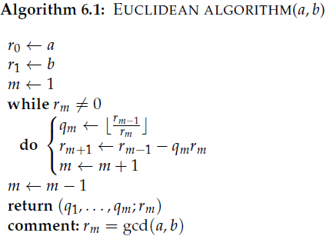
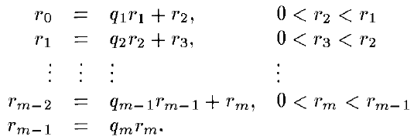
1) The basic Euclidean Algorithm
To compute the GCD r of a and b
Long division method
a→
b→
r = gcd(a, b) =
Notes:
r_{m-2} = q_{m-1}q_{m}r_{m} + r_{m}=(q_{m-1}q_{m} +1) r_{m} then r_{m} is a common divisor of r_{m-2} and r_{m-1}.
Set t = gcd (r_{m-2}, r_{m-1}) ≥ r_{m}, then it is easy to prove that t | r_{m}. Hence, t= r_{m}.

Slide 13
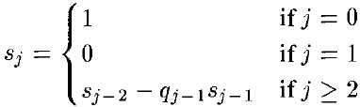
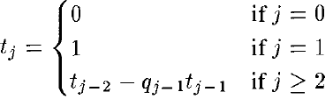
2) The Extended Euclidean Algorithm
From Algorithm 6.1:
a→
r₂ = r₀ – q₁ r₁
r₃ = r₁ – q₂ r₂
= r₁ – q₂ (r₀ – q₁ r₁)
= – q₂ r₀ + (1+ q₂ q₁) r₁
……
b→
r_{m}= s_{m}r₀ + t_{m}r₁ ←→ r = sa + tb

Slide 14
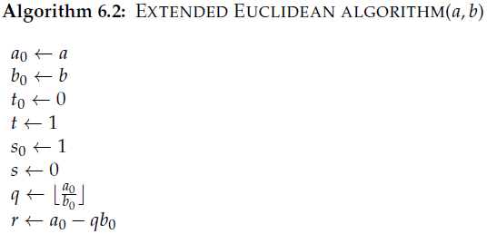
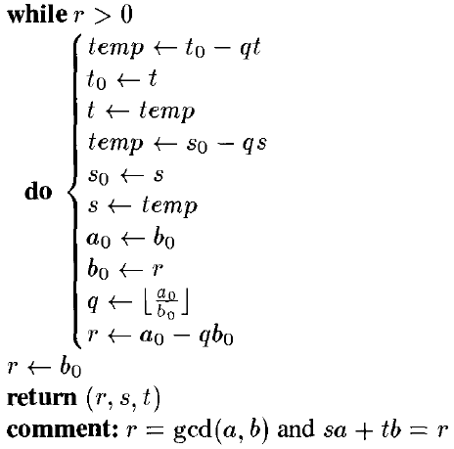
2) The Extended Euclidean Algorithm
To obtain the GCD r of a and b with r = sa + tb
Initialization:
If r = 1, then b⁻¹ mod a = t.

Slide 15
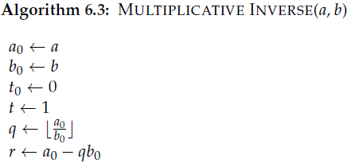
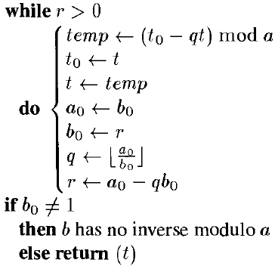
3) The Multiplicative Inverse Algorithm
To compute the multiplicative inverse of b
Initialization
If b₀ = 1, then b⁻¹ mod a = t.
Col: If , i.e., gcd(n, b) = 1,
then Multiplicative Inverse(n, b) = t = b⁻¹ mod n.

Slide 16
2.2 The Chinese Remainder Theorem (中国剩余定理)
在《孙子算经》中有这样一个问题：
“今有物不知其数，
三三数之剩二，
五五数之剩三，
七七数之剩二，
问物几何？”
这个问题称为“孙子问题”

Slide 17
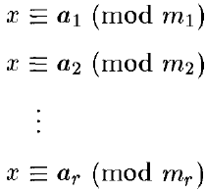
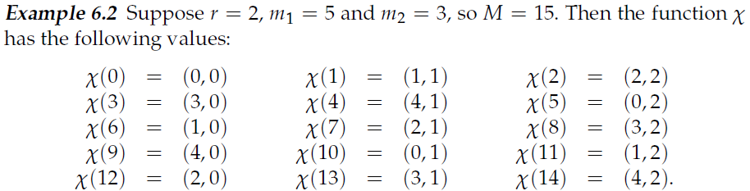
2.2 The Chinese Remainder Theorem
Define a function:
M=m₁m₂…m_{r}
gcd(m_{i}, m_{j}) = 1 if i ≠ j
The function is a bijection

Slide 18
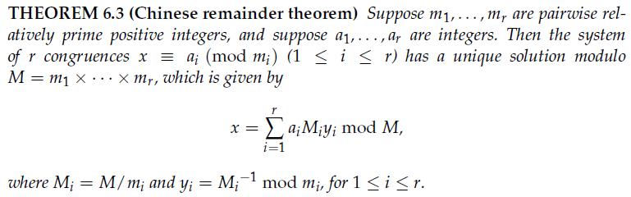
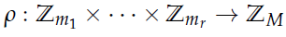
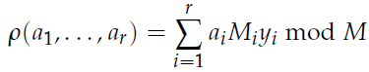
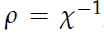
2.2 The Chinese Remainder Theorem
gcd(m_{i}, m_{j}) = 1 if i ≠ j
M=m₁m₂…m_{r}
Define functions:

Slide 19
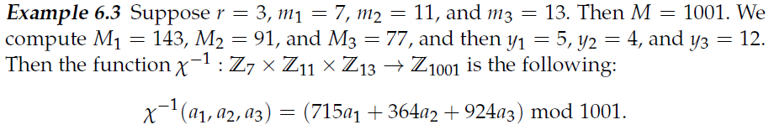
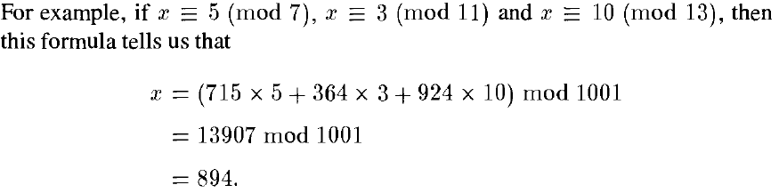
2.2 The Chinese Remainder Theorem

Slide 20
2.3 Group Theory II
Let G be a finite multiplicative group (乘法群)
Order of the group G, denoted by |G|: the number n of elements in G
Order of an element g in G: the smallest positive integer m such that g^{m} = 1
Examples: Z₄*={1,3}, ord(1)=1, ord(3)=2; (Z₄ is not a multiplicative group)
Z₅*={1,2,3,4}, ord(1)=1, ord(2)=4, ord(3)=4, ord(4)=2.
m|n

Slide 21
2.3 Group Theory II
Cyclic Group G: if there exists an element g in G such that the order of g is |G|. Such g is called a primitive element, and G can be represented as
G = {g¹, g²,…, g^{|G|-1} , g^{|G|}=1}=<g>
Examples: Z₅*={1,2,3,4}, ord(1)=1, ord(2)=4, ord(3)=4, ord(4)=2;
Z₅* =<2> = <3>: 3¹ (mod5) =3, 3² (mod5)=4, 3³ (mod5) =2, 3⁴ (mod5) =1
A quick method to verify whether an element is a primitive element:

Slide 22
Outline
1. Introduction to Public-Key Cryptography
SKC v.s. PKC
2. Mathematical Backgrounds III
Euclidean Algorithms
The Chinese Remainder Theorem
Group Theory II
3. The RSA Cryptosystem
4. Implementing RSA and Complexity
5. Attacks on RSA
6. The Rabin Cryptosystem
7. Semantic Security of RSA

Slide 23
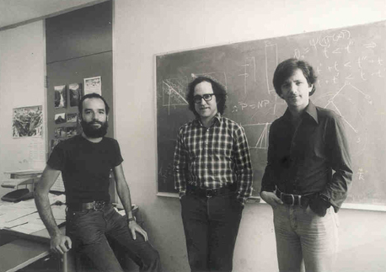
Introduction to RSA
Background of RSA cryptosystem
1977, Rivest, Shamir and Adleman, MIT
Contributions:
RSA is the first practical PKC (public-key cryptosystem)
Encryptions & Signatures
Certificate authority (CA), SSL, E-commerce, E-government
2002, Rivest, Shamir and Adleman, Turing Award (图灵奖)
A
R
S

Slide 24
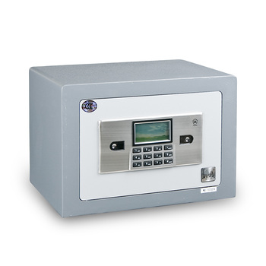


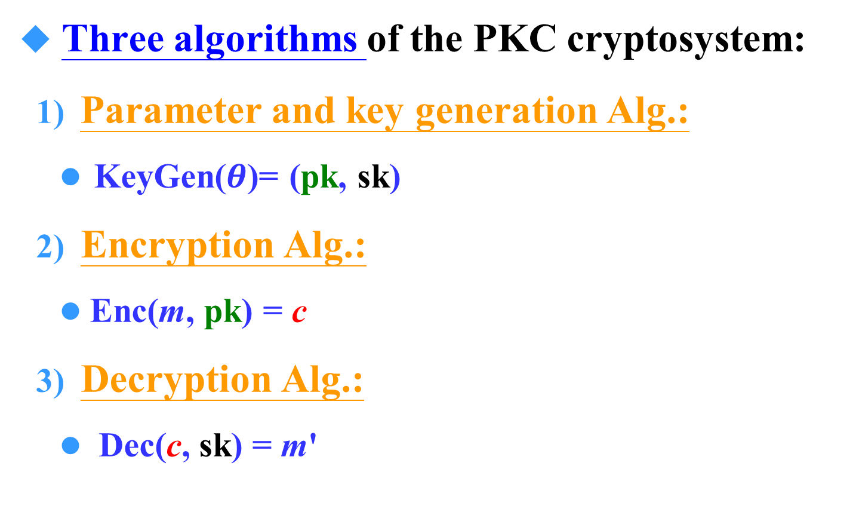
Description of PKC Cryptosystem
Three algorithms of the PKC cryptosystem:
Parameter and key generation Alg.:
KeyGen($θ$)= (pk, sk)
Encryption Alg.:
Enc(m, pk) = c
Decryption Alg.:
Dec(c, sk) = m'
Alice
Bob
Bob’s pk
Bob’s sk

Slide 25


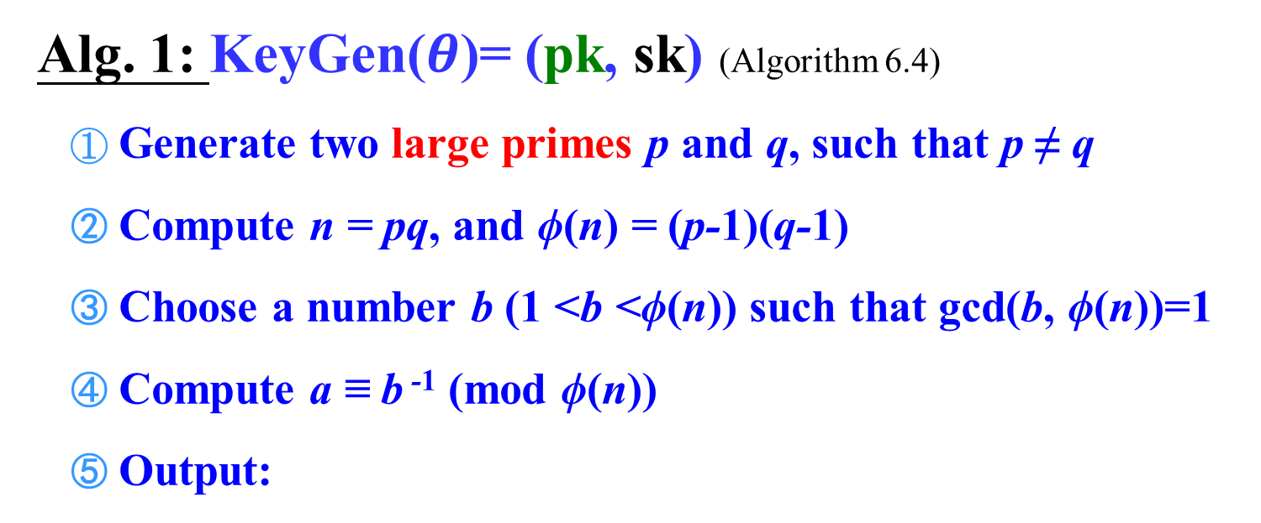
RSA-Parameter Generation Alg
Alg. 1: KeyGen($θ$)= (pk, sk) (Algorithm 6.4)
Generate two large primes p and q, such that p ≠ q
Compute n = pq, and ϕ(n) = (p-1)(q-1)
Choose a number b (1 <b <ϕ(n)) such that gcd(b, ϕ(n))=1
Compute a ≡ b ⁻¹ (mod ϕ(n))
Output:
Euclidean algorithm
pk = (n, b) is the public key
n should be large
×
sk = (p, q, a) is the secret key

Slide 26
RSA – Encryption & Decryption Algs
Alg. 2: Enc(m, pk) = c
Compute: Enc(m, pk) = m^{b} mod n = c
(Cryptosystem 6.1)
pk=(n, b) is the public key
Correctness: m = m' ?
Alg. 3: Dec(c, sk) = m'
Compute: Dec(c, sk) = cª mod n = m'
sk=(p, q, a) is the secret key

Slide 27
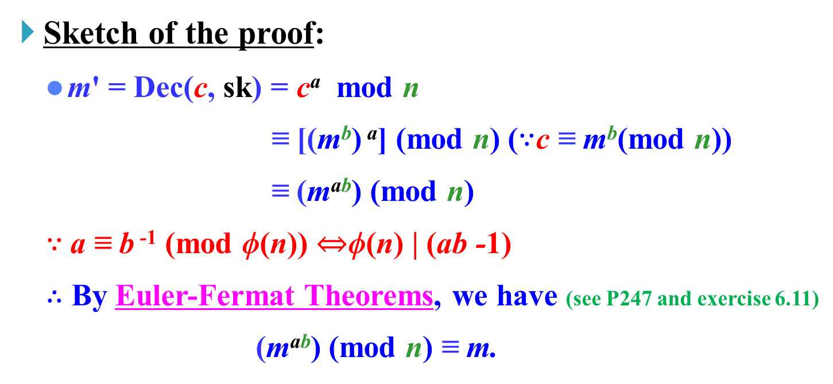
RSA - Correctness
Correctness: m = m'.
Sketch of the proof:
m' = Dec(c, sk) = cª mod n
≡ [(m^{b}) ª] (mod n) ($∵$c ≡ m^{b}(mod n))
≡ (m^{ab}) (mod n)
$∵$a ≡ b ⁻¹ (mod ϕ(n)) $⇔$ϕ(n) | (ab -1)
$∴$ By Euler-Fermat Theorems, we have (see P247 and exercise 6.11)
(m^{ab}) (mod n) ≡ m.

Slide 28

RSA-An Example
RSA
Internet
8
2
8:00
8
pk = (n, b) = (33, 7)
sk = (p, q, a) = (3, 11, 3)
Encryption: Enc(8, pk) = 8^{b} mod n = 8⁷ mod 33 = 2
Decryption: Dec(2, sk) = 2ª mod n = 2³ mod 33 = 8
28

Slide 29
Outline
1. Introduction to Public-Key Cryptography
SKC v.s. PKC
2. Mathematical Backgrounds III
3. The RSA Cryptosystem
4. Implementing RSA and Complexity
5. Attacks on RSA
6. The Rabin Cryptosystem
7. Semantic Security of RSA

Slide 30
Implementing RSA
RSA Set-up of Key Generation:
Generate two large odd primes p and q such that p ≠ q
Compute n = pq and ϕ(n) = (p-1)(q-1)
Choose a random number b (1 < b < ϕ(n)) such that gcd(b, ϕ(n))=1
Compute a ≡ b ⁻¹ (mod ϕ(n))
Output: pk = (n, b), sk = (p, q, a)
Euclidean Algorithms
RSA Encryption and Decryption:
Encryption rule: e_{K}(m) = m^{b} mod n
Decryption rule: d_{K}(c) = cª mod n
Square and Multiply Algorithm

Slide 31
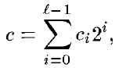
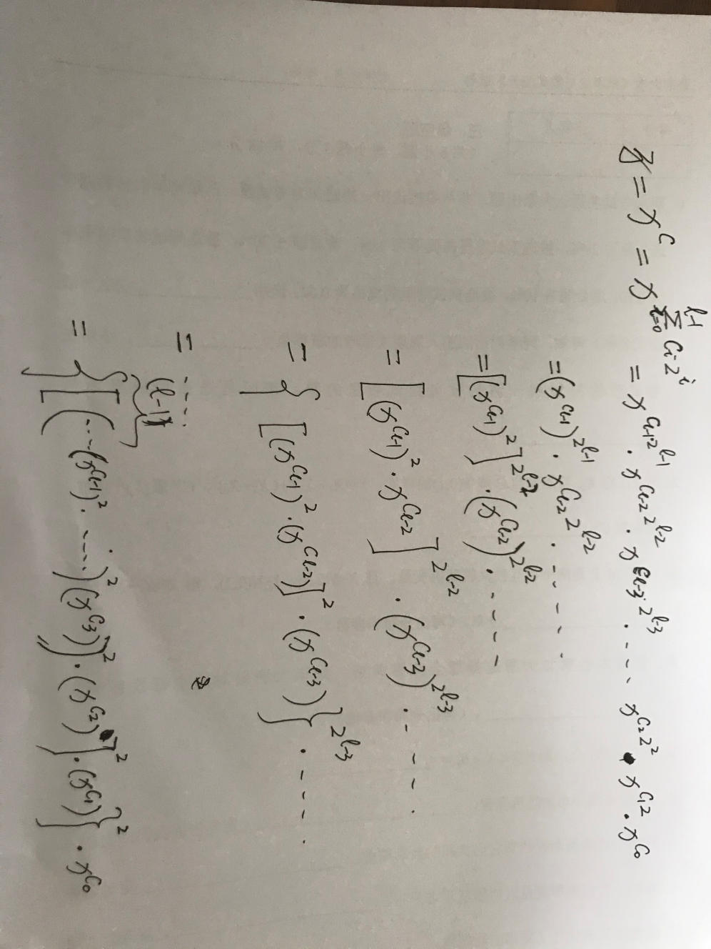
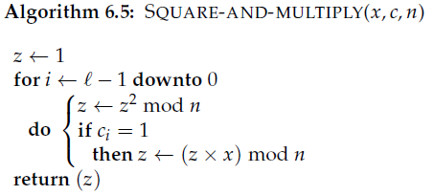
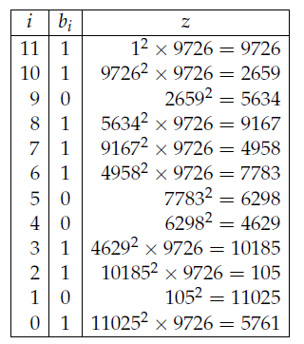
The Square and Multiply Algorithm
To compute z = x^{c} mod n:
c←→b₁₁b₁₀ … b₁b₀
O ((log(n)) ³)
Notes:
Faster method of Exponent operation modulo n
C is represented in binary

Slide 32
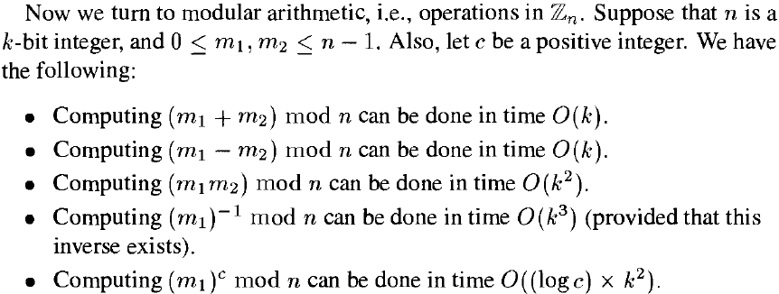
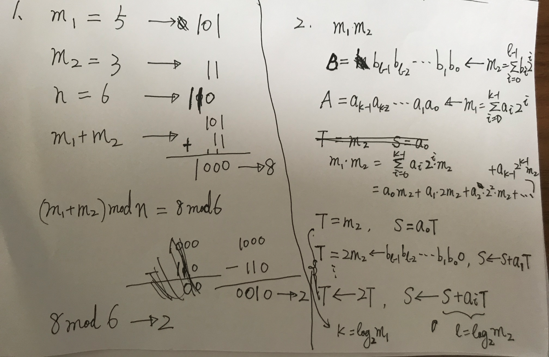
Computational Complexity
→O ((log(n)) ²)
Algorithm 6.3 Multiplicative Inverse (n, m₁)
Algorithm 6.5 Square-and-Multiply (m₁,c,n)
See 《Introduction to Algorithms》 or go to the link:
https://richardyan.site/Number-Theory-and-Group-based-Cryptography-01-Time-Complexity-of-Arithmetic/

Slide 33
Implementing RSA
RSA Set-up of Key Generation:
Generate two large odd primes p and q such that p ≠ q
Compute n = pq and ϕ(n) = (p-1)(q-1)
Choose a random number b (1 < b < ϕ(n)) such that gcd(b, ϕ(n))=1
Compute a ≡ b ⁻¹ (mod ϕ(n))
Output: pk = (n, b), sk = (p, q, a)
Miller-Rabin Algorithm
O ((log(n)) ²)
O ((log(n)) ²)
Euclidean Algorithms
RSA Encryption and Decryption:
O ((log(n)) ³)
Encryption rule: e_{K}(m) = m^{b} mod n
Decryption rule: d_{K}(c) = cª mod n
Square and Multiply Algorithm

Slide 34
Primality Testing
Generate large random primes
Generate large random number + Primality Testing
Primality Testing:
polynomial-time deterministic algorithm (2002, Agrawal, Kayal and Saxena, theoretic proof) : a breakthrough
Randomized polynomial-time Monte-Carlo algorithms (in practice):
Solovay-Strassen Algorithm
Miller-Rabin Algorithm
Testing Size: π(N) = no. of primes in [1, N]
Prime number theorem, π(N) ≈N/ln N; prob.(p is prime) ≈ 1/ln N.
O ((log(n)) ³)
O ((log(n)) ³)

Slide 35
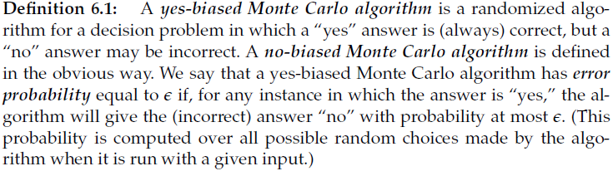
Primality Testing - Monte Carlo algorithms
Decision Problem: a question is to be answered “Yes” or “No”
A (randomized) Monte Carlo algorithm:
always gives an answer, but the answer may be incorrect
different from the Las Vegas algorithm
yes-biased MC-Alg
no-biased MC-Alg

Slide 36
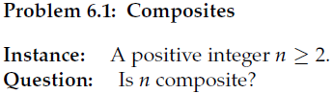
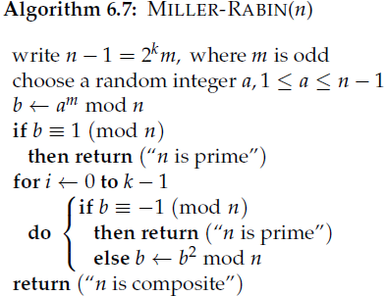
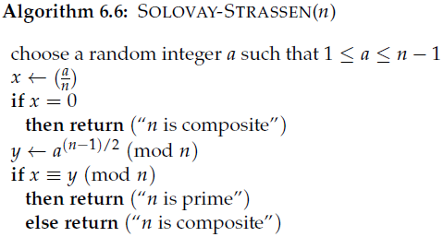
Primality Testing – Composites Probl.
Decision Problem: a question is to be answered “Yes” or “No”
A decision problem of Composites:
A yes-biased Monte Carlo Alg. with error prob. (at most) ¼.
Legendre symbol in Definition 6.3
O ((log(n)) ³)

Slide 37
Complexity of Implementing RSA
Computational Complexity: Polynomial time
RSA Set-up of Key Generation:
Generate two large odd primes p and q such that p ≠ q
Compute n = pq and ϕ(n) = (p-1)(q-1)
Choose a random number b (1 < b < ϕ(n)) such that gcd(b, ϕ(n))=1
Compute a ≡ b ⁻¹ (mod ϕ(n))
Algorithm 6.7 Miller-Rabin (p)/ (q)
O((log n)³)
O((log n)²)
Computational complexity of RSA is higher
than DES and AES
O((log n)³) → O ((log(n))²)
Algorithm 6.3 Multiplicative Inverse (b, ϕ(n))
RSA Encryption and Decryption:
Encryption rule: e_{K}(m) = m^{b} mod n
Decryption rule: d_{K}(c) = cª mod n
O((log n)³)
Algorithm 6.5
Square-and-Multiply (m,b,n) /(c,a,n)
O((log n)³)

Slide 38
Outline
1. Introduction to Public-Key Cryptography
SKC v.s. PKC
2. Mathematical Backgrounds III
3. The RSA Cryptosystem
4. Implementing RSA and Complexity
5. Security Discussion and Attacks on RSA (total break)
Fatoring n and related attack
6. The Rabin Cryptosystem
7. Semantic Security of RSA

Slide 39
Security Discussions
Belief:
Encryption c = m^{b} mod n is a one-way function
The trapdoor is the knowledge of the factorization n=pq.
pk = (n, b) is the public key
n should be large
×
sk = (p, q, a) is the secret key
Security of RSA is based on the difficulty of factorizing the large integer n=pq
the difficulty of break RSA ≤ the difficulty of factoring n.
Notes:
The security of RSA is based on the belief that the encryption function c = m^{b} mod n is a one-way function, so it will be computationally infeasible for an opponent to decrypt a ciphertext.
The trapdoor that allows Bob to decrypt a ciphertext is the knowledge of the factorization n=pq.
Breaking RSA is not harder than factoring n.

Slide 40
Algorithms of Factoring n (Skipped)
Factoring n: n=pq
Algorithms in Practice
The Quadratic Sieve Alg.
The Elliptic Curve Factoring Alg.
The Number Field Sieve
Precursor Algorithms
The Pollard Rho Alg.
The Pollard p-1 Alg.
Dixon’s Random Squares Alg.

Slide 41
Factoring n (1/3)
exhaustive search attack: by one computer with 1million executions per second
Length of Key n (bits) | Time of success attack (years)
116 | 400
129 | 5000
512 | 30000
768 | 200 000 000
1024 | 300 000 000 000
2048 | 300 000 000 000 000 000 000
Notes:
The first RSA-512 factorization in 1999 required the equivalent of 8,400 MIPS years, over an elapsed time of about seven months.^{[28]} In 2009, Benjamin Moody factored an RSA-512 bit key in 73 days using only public software (GGNFS) and his desktop computer (a dual-core Athlon64 with a 1,900 MHz cpu.). Just less than five gigabytes of disk storage was required and about 2.5 gigabytes of RAM for the sieving process.
As of 2010, the largest factored RSA number was 768 bits long (232 decimal digits, see RSA-768). Its factorization, by a state-of-the-art distributed implementation, took around fifteen hundred CPU years (two years of real time, on many hundreds of computers). No larger RSA key is known publicly to have been factored. In practice, RSA keys are typically 1024 to 4096 bits long. Some experts believe that 1024-bit keys may become breakable in the near future or may already be breakable by a sufficiently well-funded attacker, though this is disputable. Few people see any way that 4096-bit keys could be broken in the foreseeable future. Therefore, it is generally presumed that RSA is secure if n is sufficiently large. If n is 300 bits or shorter, it can be factored in a few hours in a personal computer, using software already freely available. Keys of 512 bits have been shown to be practically breakable in 1999 when RSA-155 was factored by using several hundred computers, and these are now factored in a few weeks using common hardware.^{[30]} Exploits using 512-bit code-signing certificates that may have been factored were reported in 2011.^{[31]} A theoretical hardware device named TWIRL, described by Shamir and Tromer in 2003, called into question the security of 1024 bit keys. It is currently recommended that n be at least 2048 bits long.^{[32]}
In 1994, Peter Shor showed that a quantum computer – if one could ever be practically created for the purpose – would be able to factor in polynomial time, breaking RSA; see Shor's algorithm.
针对RSA最流行的攻击一般是基于大数因数分解。1999年，RSA-155 (512 bits)被成功分解， 花了五个月时间（约8000 MIPS年）和224 CPU hours在一台有3.2G中央内存的Cray C916 计算机上完成 2002年，RSA-158也被成功因数分解 2009年12月12日，编号为RSA-768（768 bits, 232 digits）数也被成功分解, 这一事件威胁了现通行的1024-bit密钥的安全性，普遍认为用户应尽快升级到2048-bit或以上

Slide 42
Factoring n (2/3)
MPQS (Multiple polynomial quadratic sieve): by a desktop computer (Processor: Intel Dual-Core i7-4500U 1.80GHz)
Length of Key n (bits) | Time of Success Attack
128 | Less than 2 seconds
192 | 16 seconds
256 | 35 minutes
260 | 1 hour
YAFU:
……
Notes:
The first RSA-512 factorization in 1999 required the equivalent of 8,400 MIPS years, over an elapsed time of about seven months.^{[28]} In 2009, Benjamin Moody factored an RSA-512 bit key in 73 days using only public software (GGNFS) and his desktop computer (a dual-core Athlon64 with a 1,900 MHz cpu.). Just less than five gigabytes of disk storage was required and about 2.5 gigabytes of RAM for the sieving process.
Multiple polynomial quadratic sieve (MPQS) can be used to factor the public modulus n. The time taken to factor 128-bit and 256-bit n on a desktop computer (Processor: Intel Dual-Core i7-4500U 1.80GHz) are respectively 2 seconds and 35 minutes.
针对RSA最流行的攻击一般是基于大数因数分解。1999年，RSA-155 (512 bits)被成功分解， 花了五个月时间（约8000 MIPS年）和224 CPU hours在一台有3.2G中央内存的Cray C916 计算机上完成 2002年，RSA-158也被成功因数分解 2009年12月12日，编号为RSA-768（768 bits, 232 digits）数也被成功分解, 这一事件威胁了现通行的1024-bit密钥的安全性，普遍认为用户应尽快升级到2048-bit或以上

Slide 43
Factoring n (3/3)
Insecure n:
1999, RSA-155(155 digits, 512bits), about 7 months;
2009, RSA-155(155 digits, 512bits), 73days in one desktop;
2009~2010, RSA-232(232 digits, 768 bits), distributed system of hundreds of computers, 2 years
2018, August, RSA-230(230 digits),
2019, December, RSA-240(240 digits, 795bits)
RSA Challenge:
http://www.rsasecurity.com/rsalabs/challenges/
https://link.springer.com/referenceworkentry/10.1007%2F0-387-23483-7_362
http://unsolvedproblems.org/index_files/RSA.htm
Notes:
The first RSA-512 factorization in 1999 required the equivalent of 8,400 MIPS years, over an elapsed time of about seven months.^{[28]} In 2009, Benjamin Moody factored an RSA-512 bit key in 73 days using only public software (GGNFS) and his desktop computer (a dual-core Athlon64 with a 1,900 MHz cpu.). Just less than five gigabytes of disk storage was required and about 2.5 gigabytes of RAM for the sieving process.
As of 2010, the largest factored RSA number was 768 bits long (232 decimal digits, see RSA-768). Its factorization, by a state-of-the-art distributed implementation, took around fifteen hundred CPU years (two years of real time, on many hundreds of computers). No larger RSA key is known publicly to have been factored. In practice, RSA keys are typically 1024 to 4096 bits long. Some experts believe that 1024-bit keys may become breakable in the near future or may already be breakable by a sufficiently well-funded attacker, though this is disputable. Few people see any way that 4096-bit keys could be broken in the foreseeable future. Therefore, it is generally presumed that RSA is secure if n is sufficiently large. If n is 300 bits or shorter, it can be factored in a few hours in a personal computer, using software already freely available. Keys of 512 bits have been shown to be practically breakable in 1999 when RSA-155 was factored by using several hundred computers, and these are now factored in a few weeks using common hardware.^{[30]} Exploits using 512-bit code-signing certificates that may have been factored were reported in 2011.^{[31]} A theoretical hardware device named TWIRL, described by Shamir and Tromer in 2003, called into question the security of 1024 bit keys. It is currently recommended that n be at least 2048 bits long.^{[32]}
In 1994, Peter Shor showed that a quantum computer – if one could ever be practically created for the purpose – would be able to factor in polynomial time, breaking RSA; see Shor's algorithm.

Slide 44
Secure n
Currently Secure n:
1024-bit, 2048-bit, 3072-bit, 4096-bit
Challenges: A Quantum Computer would be able to factor large n in polynomial time and then break RSA
Notes:
The first RSA-512 factorization in 1999 required the equivalent of 8,400 MIPS years, over an elapsed time of about seven months.^{[28]} In 2009, Benjamin Moody factored an RSA-512 bit key in 73 days using only public software (GGNFS) and his desktop computer (a dual-core Athlon64 with a 1,900 MHz cpu.). Just less than five gigabytes of disk storage was required and about 2.5 gigabytes of RAM for the sieving process.
As of 2010, the largest factored RSA number was 768 bits long (232 decimal digits, see RSA-768). Its factorization, by a state-of-the-art distributed implementation, took around fifteen hundred CPU years (two years of real time, on many hundreds of computers). No larger RSA key is known publicly to have been factored. In practice, RSA keys are typically 1024 to 4096 bits long. Some experts believe that 1024-bit keys may become breakable in the near future or may already be breakable by a sufficiently well-funded attacker, though this is disputable. Few people see any way that 4096-bit keys could be broken in the foreseeable future. Therefore, it is generally presumed that RSA is secure if n is sufficiently large. If n is 300 bits or shorter, it can be factored in a few hours in a personal computer, using software already freely available. Keys of 512 bits have been shown to be practically breakable in 1999 when RSA-155 was factored by using several hundred computers, and these are now factored in a few weeks using common hardware.^{[30]} Exploits using 512-bit code-signing certificates that may have been factored were reported in 2011.^{[31]} A theoretical hardware device named TWIRL, described by Shamir and Tromer in 2003, called into question the security of 1024 bit keys. It is currently recommended that n be at least 2048 bits long.^{[32]}
In 1994, Peter Shor showed that a quantum computer – if one could ever be practically created for the purpose – would be able to factor in polynomial time, breaking RSA; see Shor's algorithm.

Slide 45
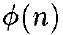
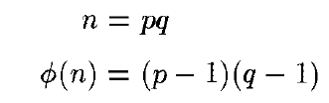
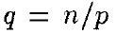
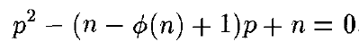
Computing
Computing the Euler Function to attack RSA
The two roots will be p and q, where n=pq.
pk = (n, b) is the public key
sk = (p, q, a) is the secret key

Slide 46
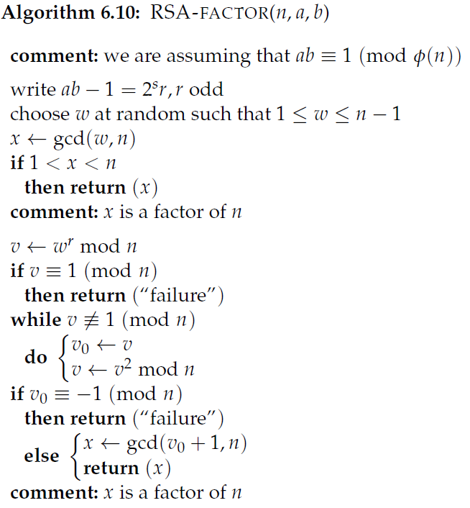
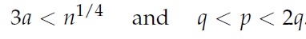
Computing a
Computing the Decryption Exponent a to attack RSA:
Computing a is no easier than factoring n.
If the decryption exponent a is known, then n can be factored in polynomial time by means of a randomized algorithm.
Algorithm 6.10 (P226)
Once a is revealed, a new modulus n should be chosen.
Wiener’s Low Decryption Exponent Attack: for some special cases
Algorithm 6.11
sk = (p, q, a) is the secret key

Slide 47
Outline
1. Introduction to Public-Key Cryptography
SKC v.s. PKC
2. Mathematical Backgrounds III
3. The RSA Cryptosystem
4. Implementing RSA and Complexity
5. Security Discussions and Attacks on RSA
6. The Rabin Cryptosystem
Turing Reduction
7. Semantic Security of RSA

Slide 48
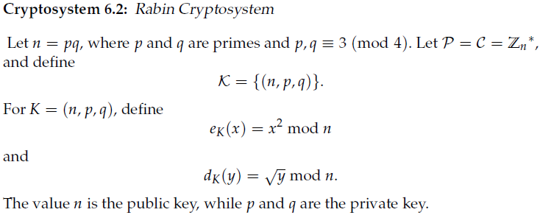
The Rabin Cryptosystem
A drawback in decryption
It is a provably secure cryptosystem:
computationally secure against a chosen-plaintext attack
If the problem of factoring is computationally infeasible, then the Rabin Cryptosystem is secure.

Slide 49
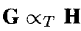
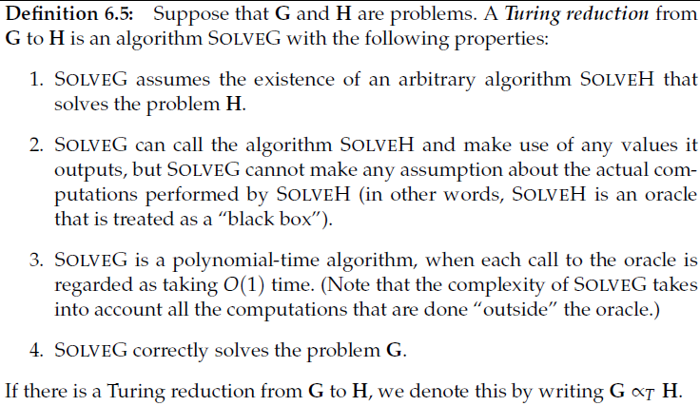
Turing Reduction
Turing Reduction from G to H:

Slide 50
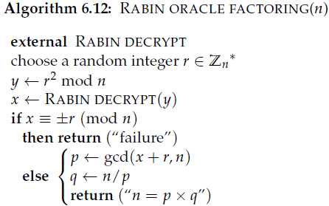
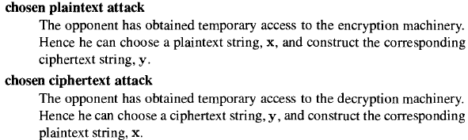
Security of the Rabin Cryptosystem
Turing Reduction
(1/2, 1)-algorithm---
The Rabin Cryptosystem is provably secure against a chosen-plaintext attack.
By Theorem 6.13
The Rabin Cryptosystem is completely insecure against a chosen-ciphertext attack.
If there is a polyn. time alg. to decrypt Rabin, then n can be factored in polyn. time.

Slide 51
Outline
1. Introduction to Public-Key Cryptography
SKC v.s. PKC
2. Mathematical Backgrounds III
3. The RSA Cryptosystem
4. Implementing RSA and Complexity
5. Attacks on RSA
6. The Rabin Cryptosystem
Turing Reduction
7. Semantic Security

Slide 52
Different Attack Goals
Total Break: to know the private key or the secret key
Partial Break: be able to decrypt a previously unseen ciphertext without the key, or to determine some specific information about the plaintext given the ciphertext, with non-negligible probability
Distinguishability of Ciphertexts: be able to distinguish between encryptions of two given plaintexts, or between an encryption of a given plaintext and a random string, with probability exceeding 1/2
Notes:
A List of Potential adversarial goals:

Slide 53
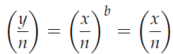
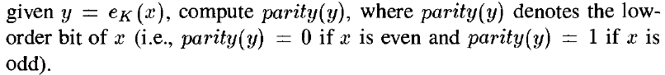
Partial break of RSA
Given y, where y = x^{b} mod n and that gcd(b, ϕ(n))=1, it must be the case that b is odd.
leakage of Jacobi symbol --
Type 1:
Type 2:
RSA does not leak these two types of information provided that RSA encryption is secure.
Turing reduction from RSA decryption to half(y)

Slide 54
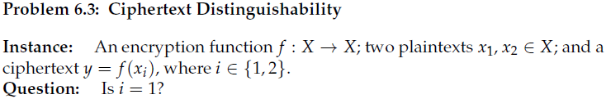
Semantic Security
A cryptosystem is said to achieve semantic security if the adversary cannot (in polynomial time) distinguish ciphertexts.
RSA encryption is secure if the length of n is at least 2048 bits.

Slide 55
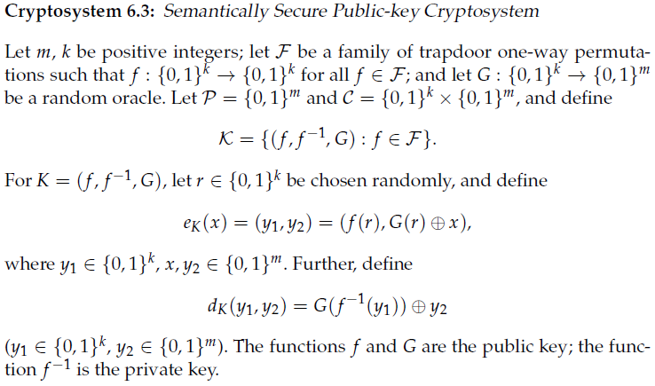
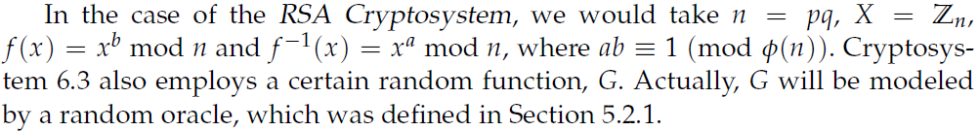
Semantic Security of PKC (skipped)
RSA encryption is secure if the length of n is at least 2048 bits.

Slide 56
Semantic Security of PKC (skipped)
Cryptosystem 6.3 is semantically secure in the random oracle model.

Slide 57
Summary
1. Introduction to Public-Key Cryptography
SKC v.s. PKC
2. Mathematical Backgrounds III
Euclidean Algorithms
The Chinese Remainder Theorem
Group Theory II
3. The RSA Cryptosystem
4. Implementing RSA and Complexity
5. Security Discussions and Attacks on RSA
6. The Rabin Cryptosystem
Turing Reduction
7. Semantic Security of RSA

Slide 58
Homework
Problem Set 5: Exercises 6.3, 6.4, 6.5, 6.7, 6.11, 6.15, 6.16.

Slide 59

Thank you!
Questions?

